Slide 1
CAD Trainings
LEGOOO!!!!

Slide 2
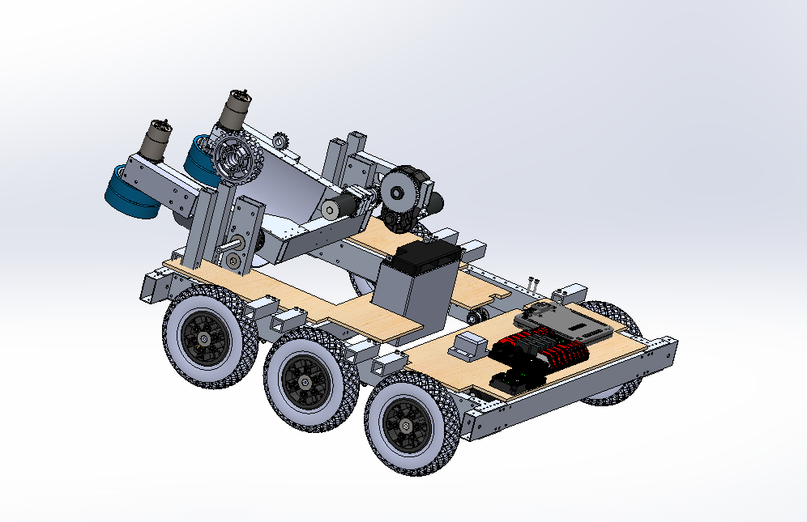

What is CAD and how do we use it?
CAD is computer aided design
Used as the instructions when fabricating and piecing together the robot
Solidworks
Lots of features
Relatively easy to use

Slide 3
The 3 Parts of Solidworks
Part - The individual components for creating the robot
Example: 2x1, gussets, wheels, bearings, etc
Assembly - Connecting the various parts together and creating 1 complete structure
Drawings - A 2d sketch with measurements for a machinist to use

Slide 4
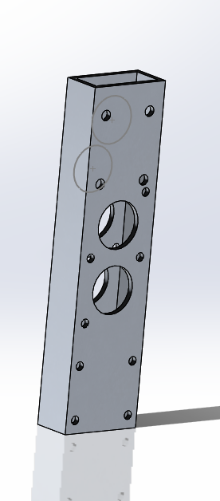
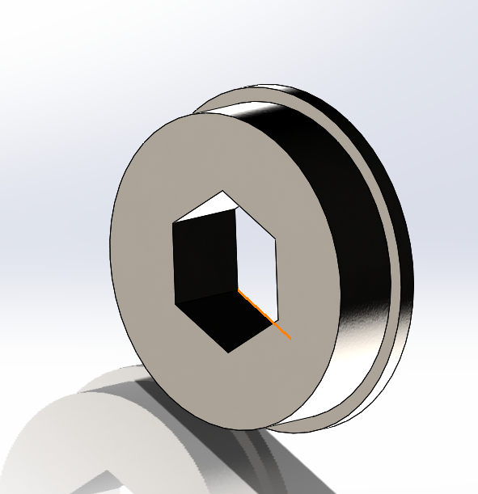
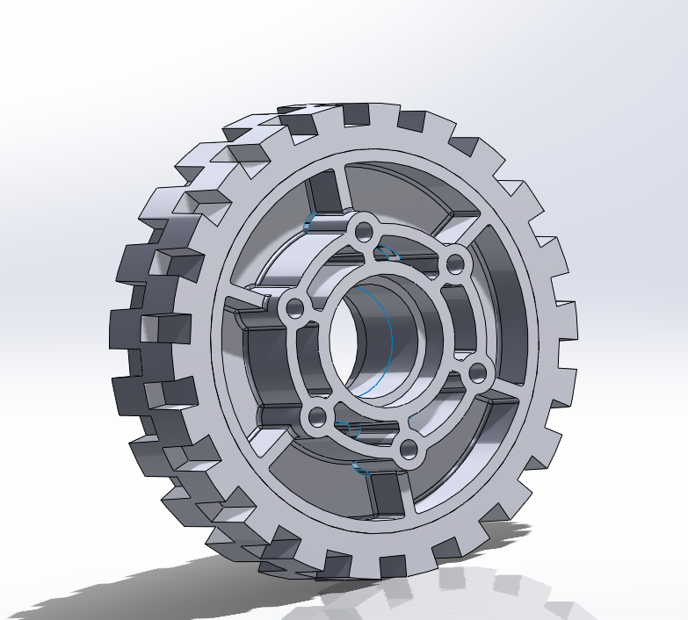
Examples of Parts

Slide 5
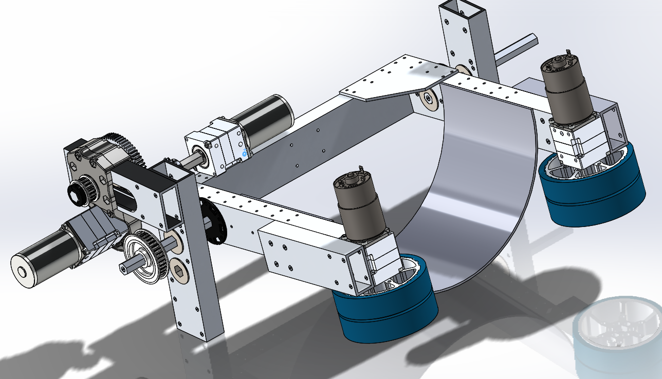
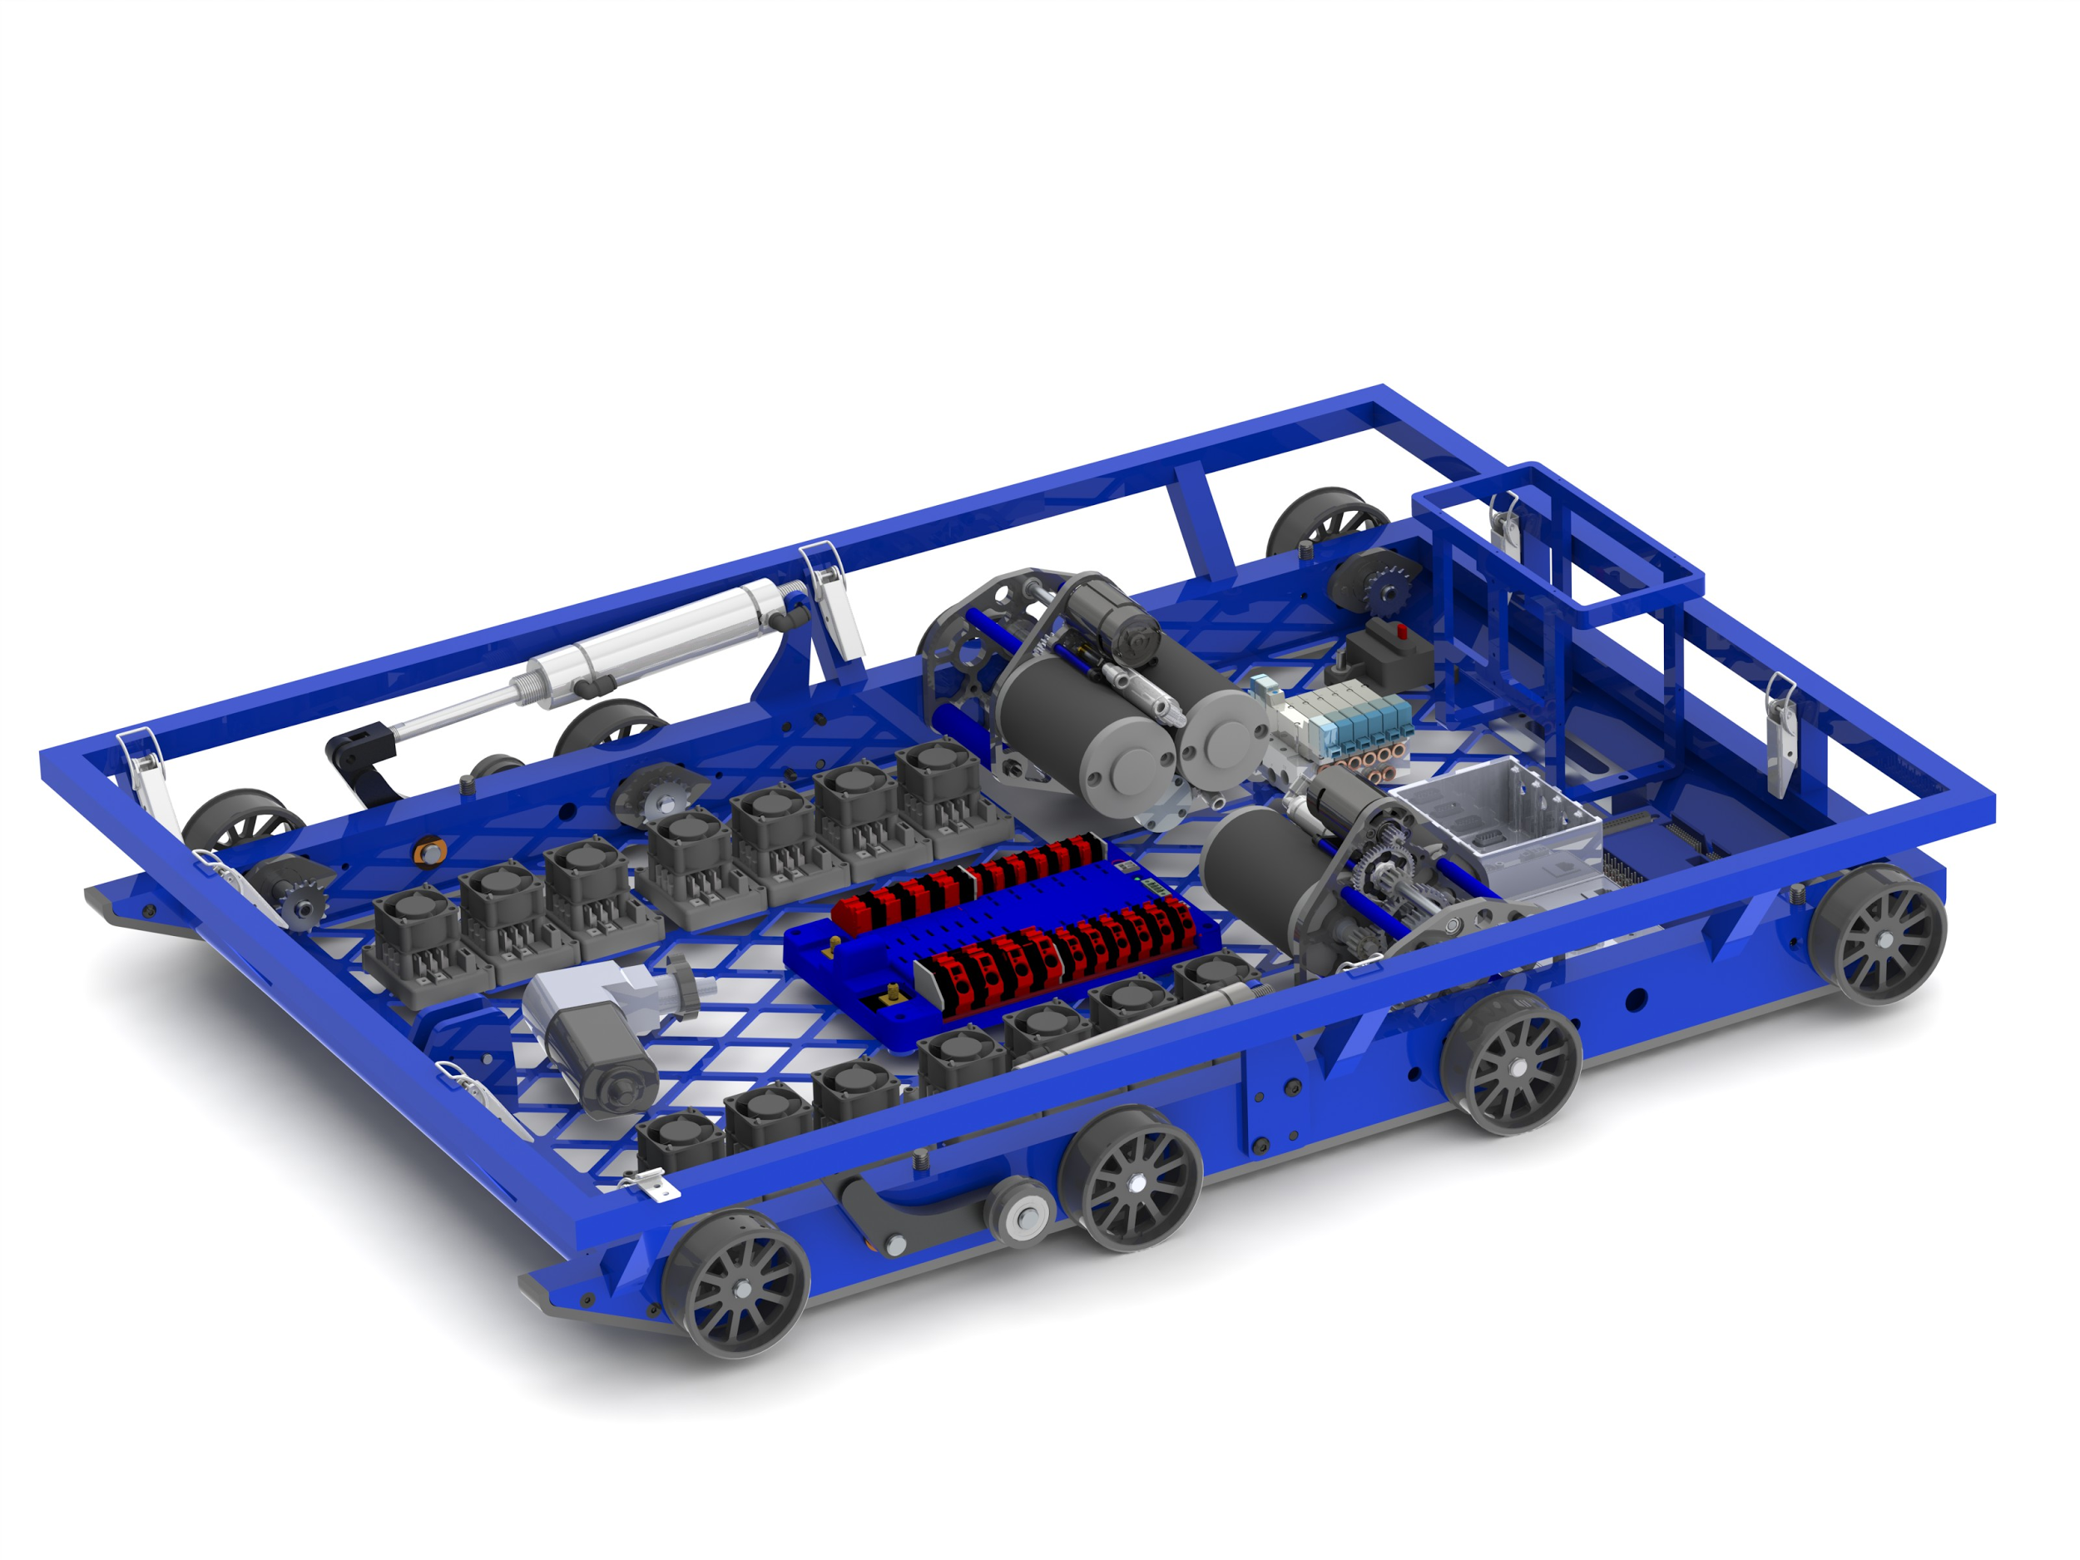
Examples of Assemblies

Slide 6
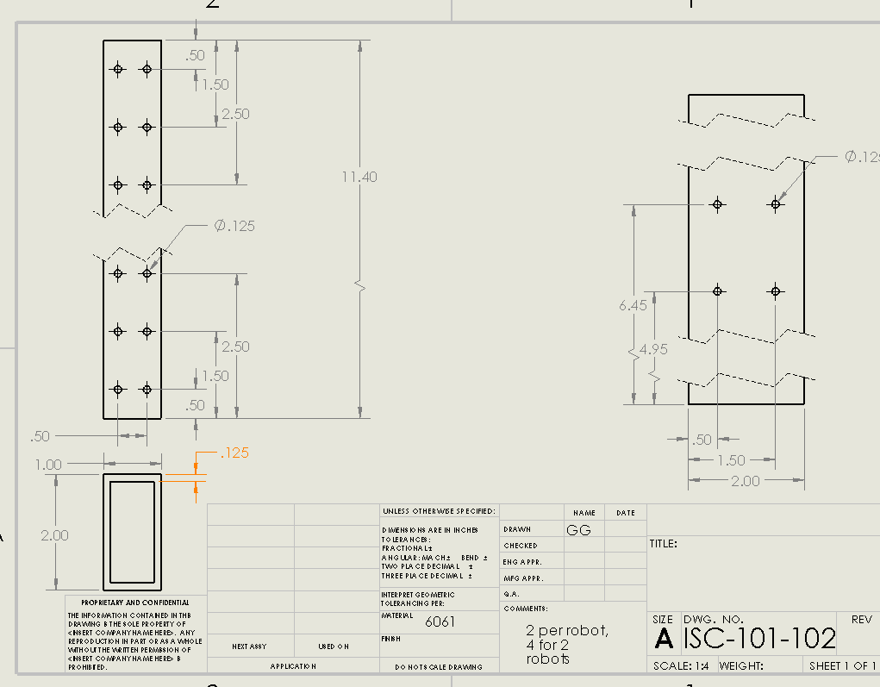
Examples of Drawings

Slide 7
Designing Step 1 - 2d layout sketching
Used to figure out the initial geometries after prototyping
MUST layout before starting to 3d design a complicated part
Majority of the design happens during this phase of CAD

Slide 8
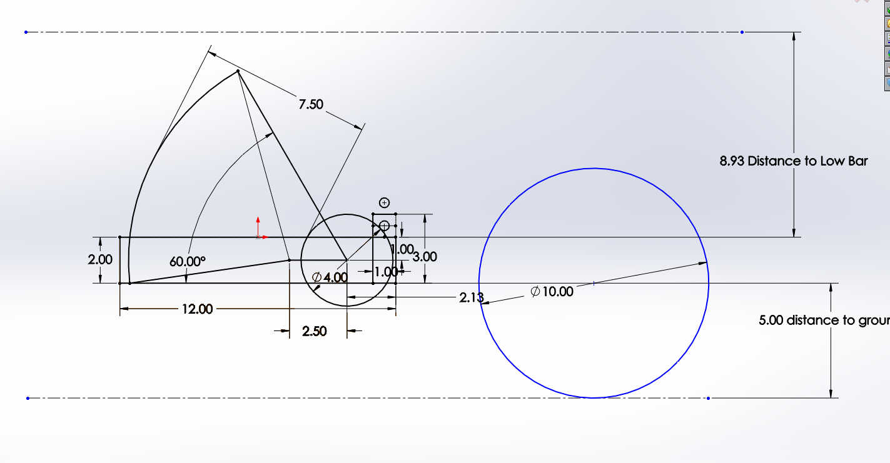

Slide 9
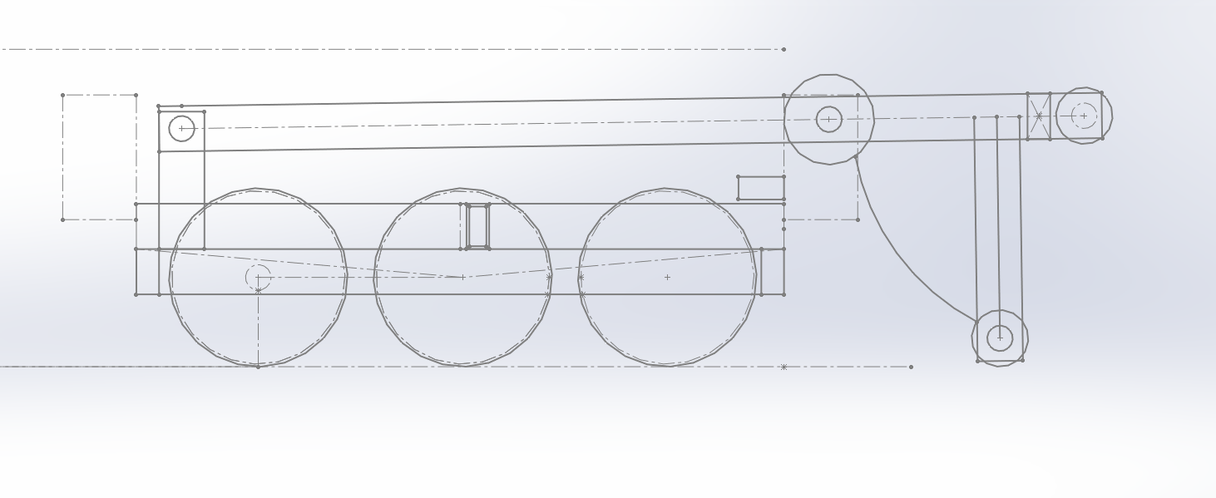

Slide 10
Designing Step 2 - Creating Parts
Manipulator split into several components for manufacturing
Easier to Machine, Allows for Parallelism
Requires more time to assemble
Greater the parts, lower the strength

Slide 11
Designing Step 3 - Assembling Parts
Individual Parts are put together in one file
Gives accurate overview of mechanism as a whole
Allows for error detection, interference, and some preliminary testing
Mass properties
Robot split into subassemblies, usually by manipulator

Slide 12
Goals for this training
You should learn to use the basics of solidworks
Basic Parts (2x1)
Creating Assemblies
Creating Technical Drawings
Learn 2D sketches

Slide 13
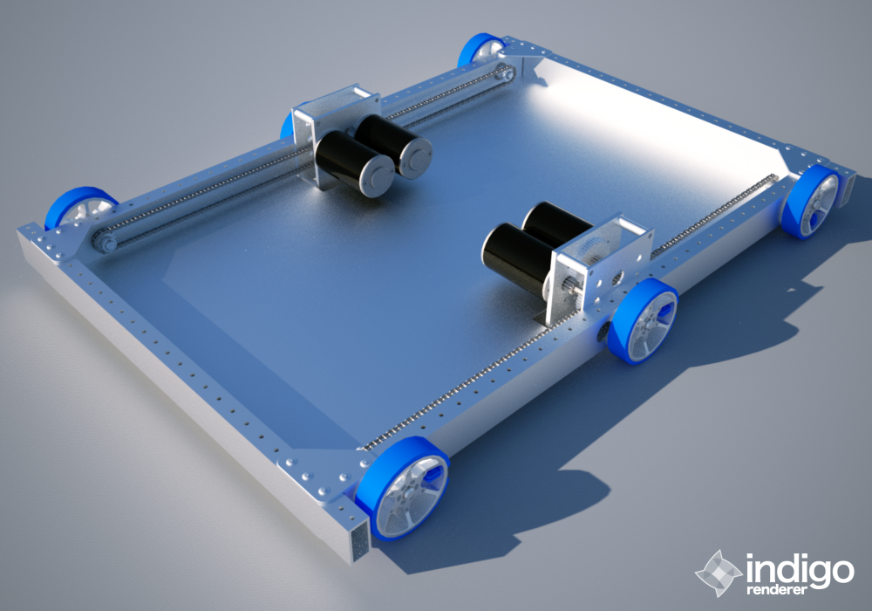
First Project: West Coast Drive
Usually 6 wheels
Dropped Center
Gearbox on the inside
Wheels on the outside
Easy to fix
Easy to make
Left and right sides of the robot are driven independently.
U shaped or rectangular

Slide 14
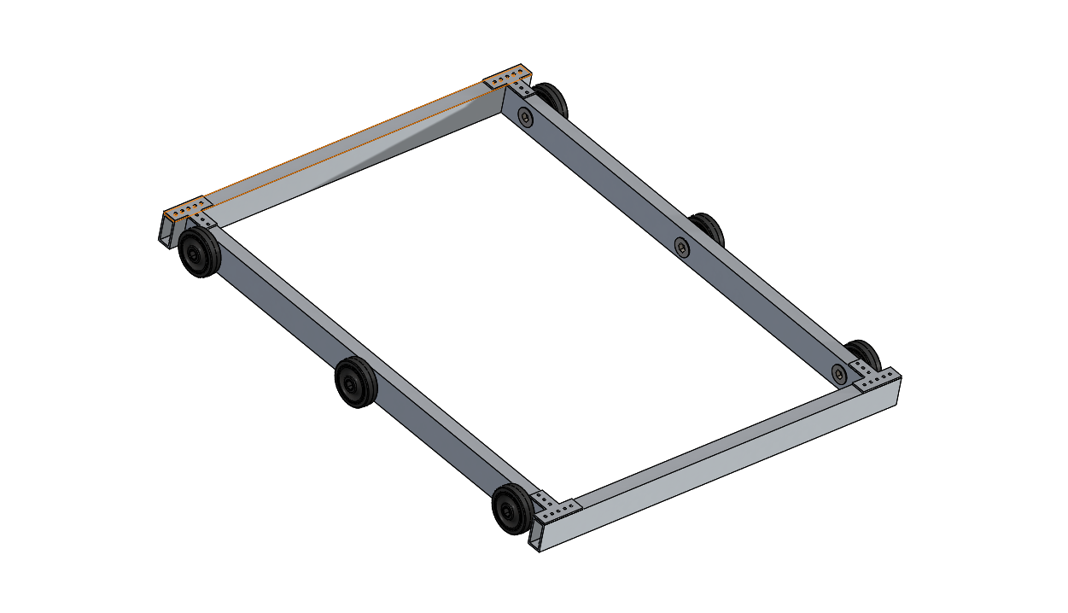

Slide 15
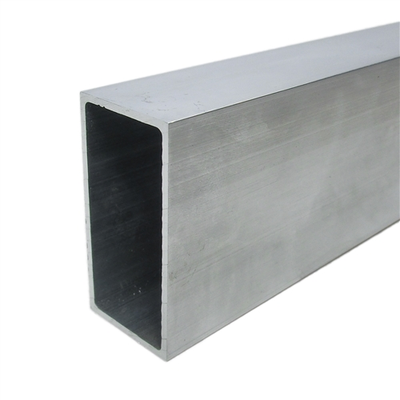
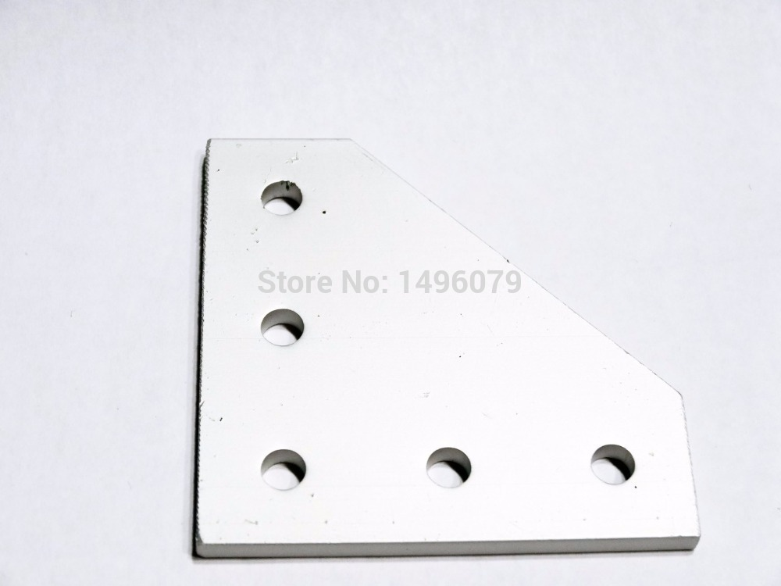
Parts Needed for this Build
2x1 aluminum
Gusset plates

Slide 16
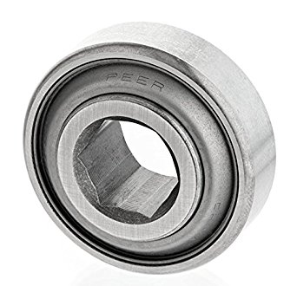
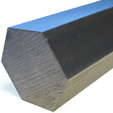
Parts: continued
Hex Bearings
Hex Shaft

Slide 17
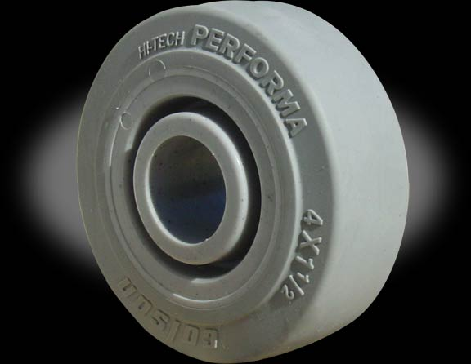
Parts: Continued Part 2
Colson wheels
Have good Traction/Grip

Slide 18
Lets Get Started
Get to learn how solidworks works, and understand how to use the tools.
Don’t get Frustrated
Work With your Group

